Slide 1



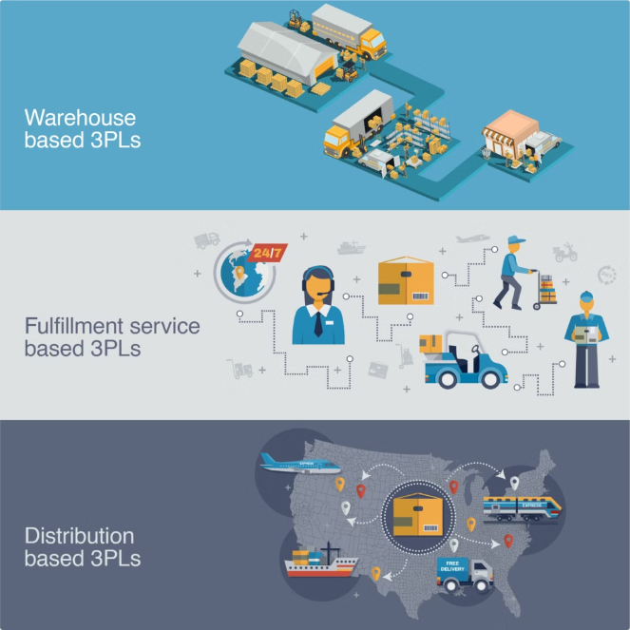
Introduction to Supply Chain Management Enterprise Applications
Supply chain management (SCM) enterprise applications are sophisticated software systems that help organizations streamline and optimize their entire supply chain, from procurement and inventory to distribution and customer service. These powerful tools enable companies to improve efficiency, reduce costs, and enhance customer satisfaction.
By Team :-
2210030108 V A SAI VENKATESH
2210030150 DHRUVA
2210030128 SOHAN
2210030017 CHARAN

Slide 2


Key Challenges in Supply Chain Management
Visibility
Collaboration
Responsiveness
Gaining real-time visibility into inventory levels, order status, and shipment tracking across the entire supply chain.
Fostering effective communication and coordination between suppliers, manufacturers, logistics providers, and customers.
Quickly adapting to changes in demand, disruptions, and other unexpected events to minimize impact on operations.

Slide 3

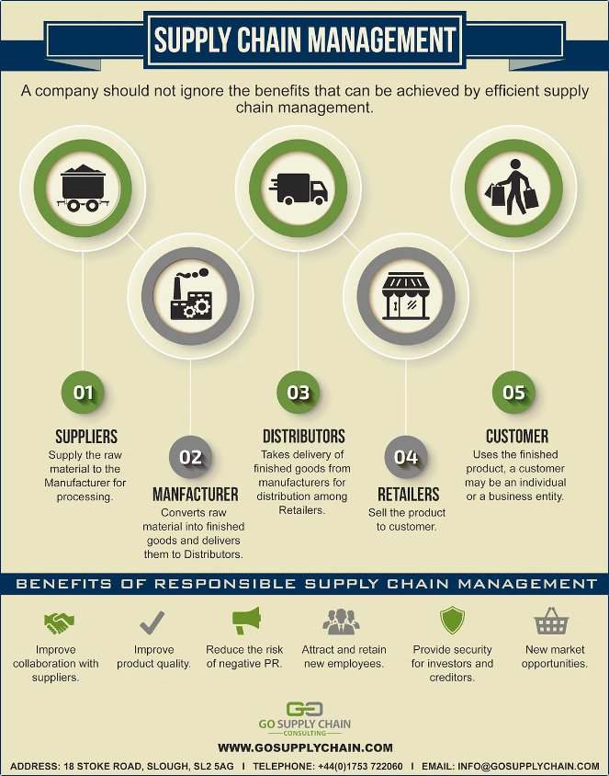
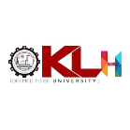
Benefits of Implementing Supply Chain Management Applications
1
Improved Efficiency
Streamline processes, reduce manual tasks, and optimize resource utilization.
2
Cost Savings
Decrease inventory carrying costs, transportation expenses, and overall operational expenditures.
3
Enhanced Customer Service
Faster order fulfillment, better visibility into delivery status, and increased customer satisfaction.
4
Data-Driven Decisions
Leverage real-time analytics to make informed, strategic choices about the supply chain.

Slide 4


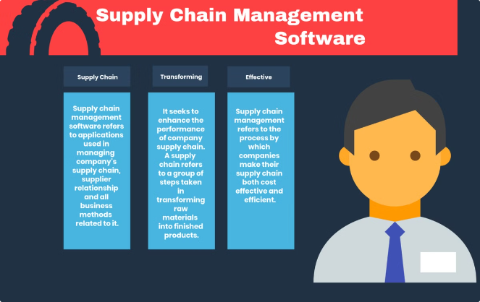
Selecting the Right Supply Chain Management Solution
Identify Needs
Thoroughly assess your organization's specific supply chain requirements and pain points.
Evaluate Vendors
Research and compare SCM software providers based on features, integration capabilities, and industry expertise.
Assess Scalability
Ensure the solution can accommodate your business growth and evolving supply chain requirements.
Consider Total Cost
Evaluate not just the software license, but also implementation, training, and ongoing maintenance costs.

Slide 5




Integrating Supply Chain Management with Enterprise Systems
ERP
CRM
Business Intelligence
Integrate SCM with your organization's Enterprise Resource Planning (ERP) system for end-to-end visibility.
Connect SCM with your Customer Relationship Management (CRM) platform to enhance customer service.
Leverage business intelligence tools to analyze supply chain data and drive informed decision-making.

Slide 6


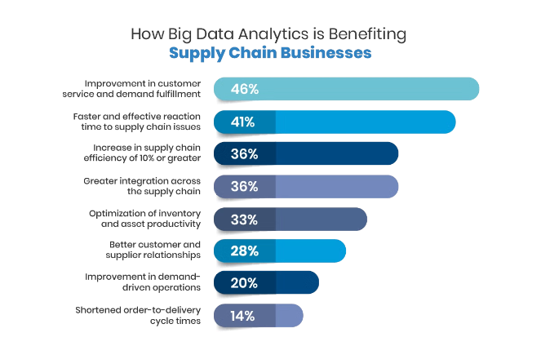




Optimizing Supply Chain Processes with Data Analytics
Demand Forecasting
Leverage predictive analytics to accurately forecast demand and optimize inventory levels.
Route Optimization
Use advanced analytics to plan the most efficient transportation routes and reduce logistics costs.
Supplier Performance
Monitor and analyze supplier data to identify opportunities for improvement and risk mitigation.
Inventory Management
Optimize inventory levels and distribution across the supply chain to minimize carrying costs.

Slide 7


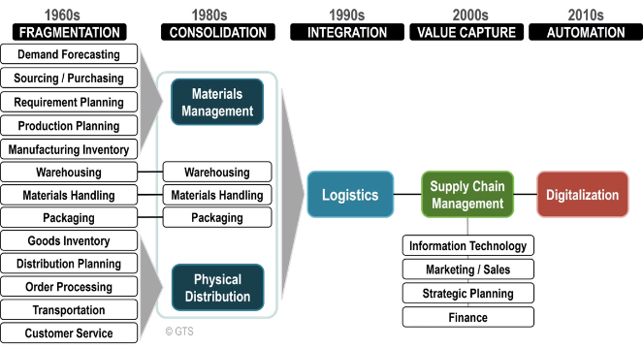
Change Management and User Adoption
1
Stakeholder Engagement
Involve key stakeholders throughout the implementation process to ensure buy-in and support.
2
User Training
Provide comprehensive training to ensure employees are comfortable using the new SCM system.
3
Process Alignment
Align supply chain processes and workflows to maximize the benefits of the new technology.

Slide 8

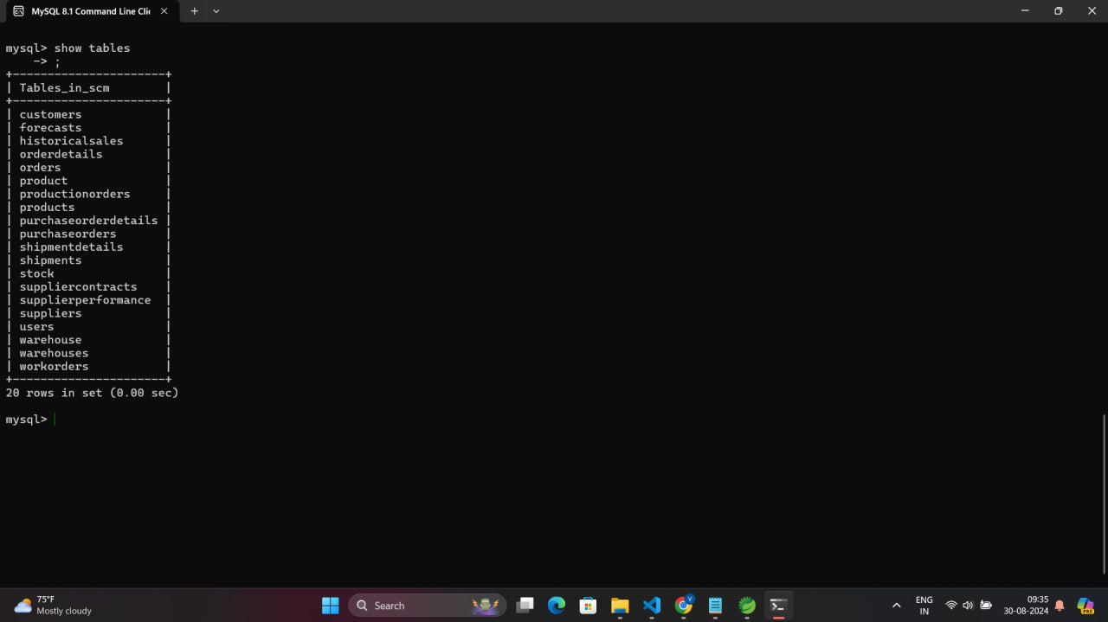
Table:1 Tables shown below for implementing Supply-Chain Management

Slide 9
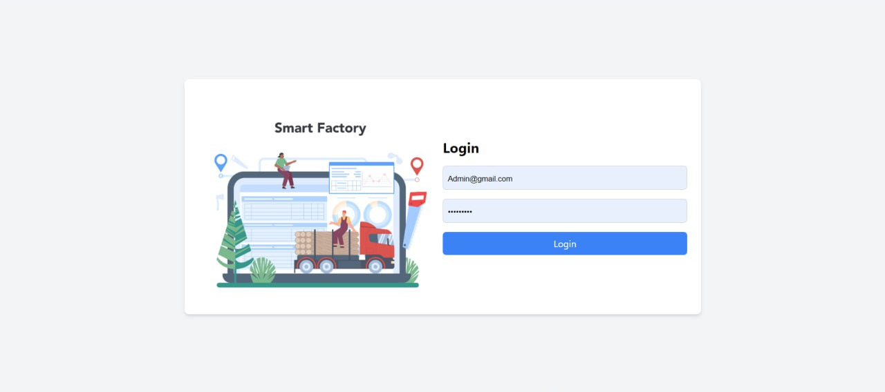
Fig: (i) Slide shown below for implementing Login page wrt Supply-Chain Management

Slide 10
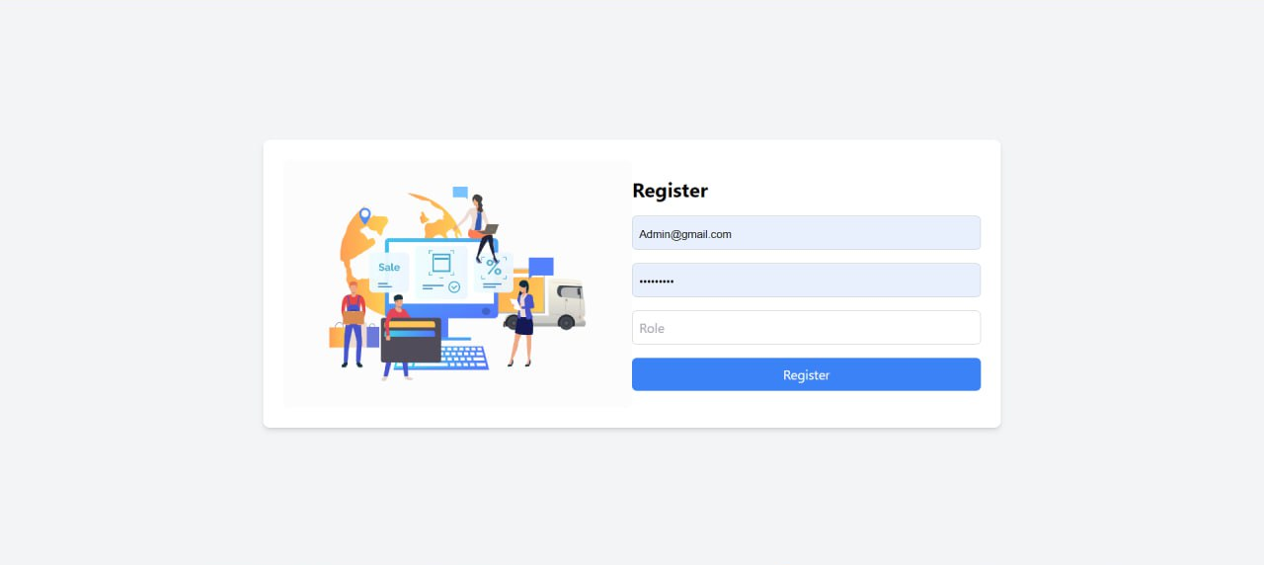
Fig: (ii) Slide shown below for implementing Sign-in page wrt Supply-Chain Management

Slide 11
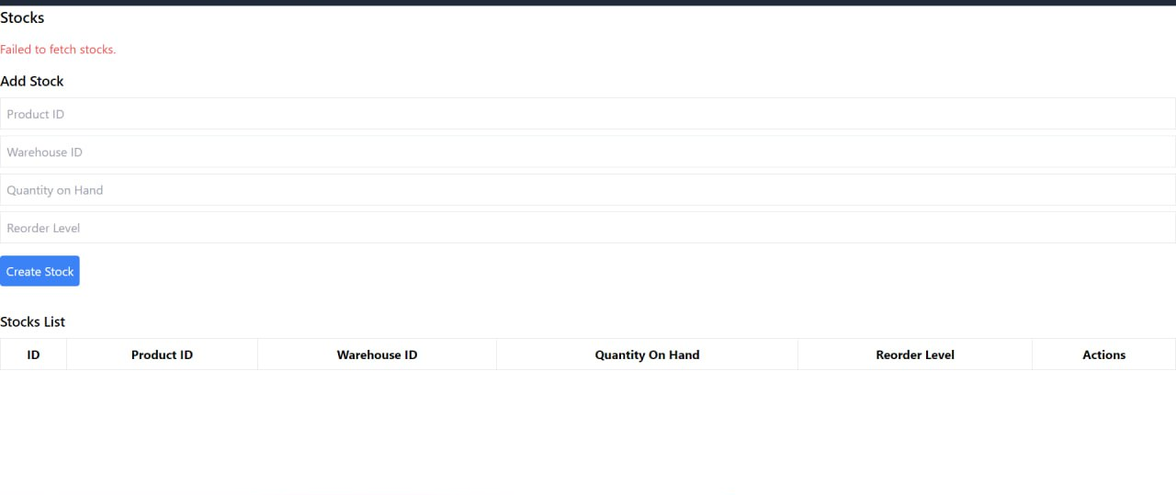
Fig:1 Slide shown below for implementing stocks Supply-Chain Management

Slide 12
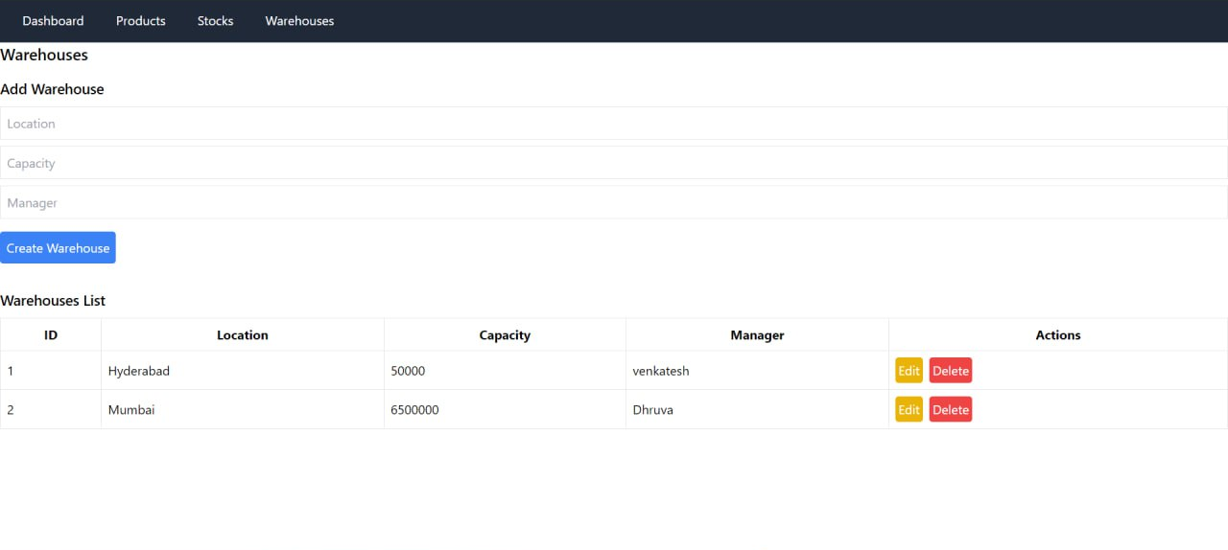
Fig:2 Slide shown below for implementing data warehouses wrt Supply-Chain Management

Slide 13
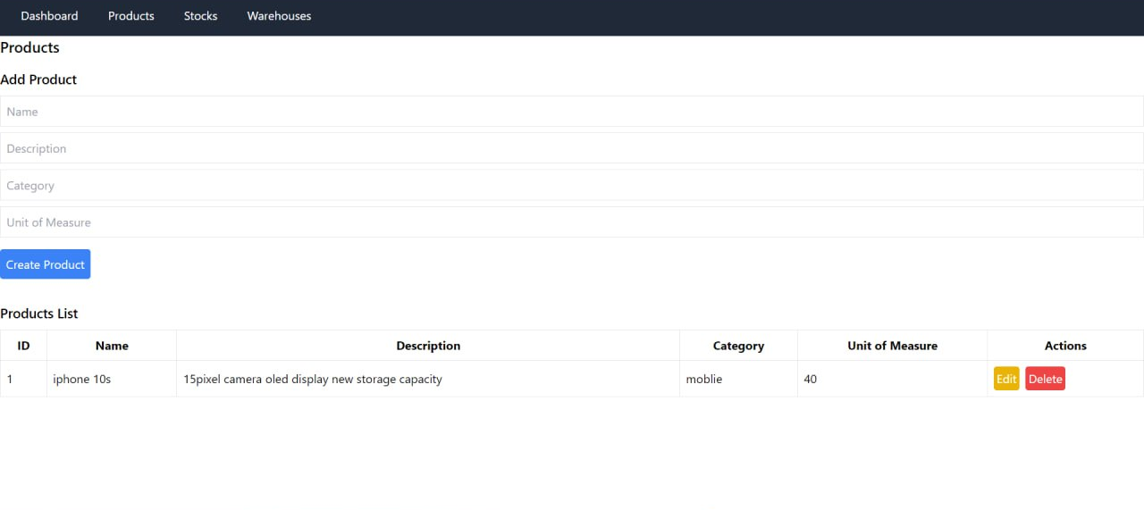
Fig:3 Slide shown below for implementing Products CRUD wrt Supply-Chain Management

Slide 14
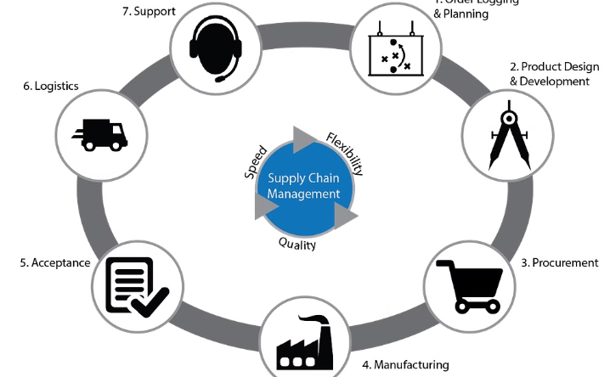
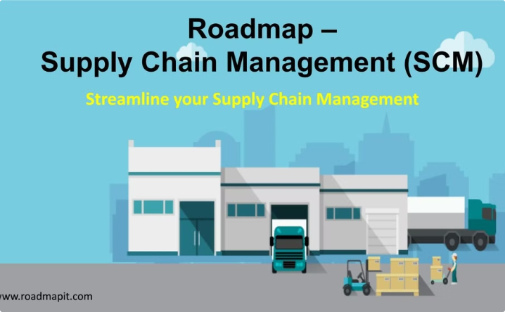
Conclusion and Next Steps
Future of SCM
Continuous Improvement
Emerging technologies like AI, blockchain, and the Internet of Things will further transform supply chain management.
Regularly review and optimize your supply chain processes to stay competitive and adaptable.

